Slide 1
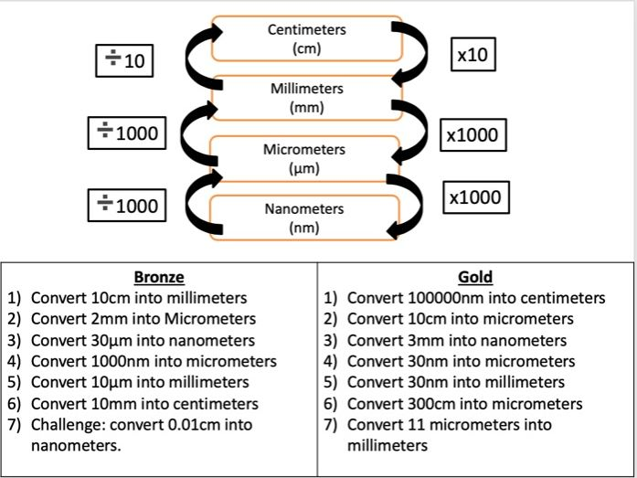
LO: To revise for Paper 1 Biology Exam
Rapid recall:

Slide 2
B1 Cell Biology Key Knowledge
State the function of the following organelles:
Mitochondria
Ribosomes
Cell membrane
Nucleus
Cytoplasm
Cell wall
Chloroplasts
Vacuole
State three differences between animal and plant cells
State the definition of a eukaryotic cell
State the definition of a prokaryotic cell
State the function of a plasmid
Explain why ribosomes rely on mitochondria to function
Describe two differences of the location of DNA in eukaryotic and prokaryotic cells
State how to improve a blurry image using a microscope
State how to improve a small image using a microscope
Describe the method used for culturing (growing) microorganisms
Explain why this must be done at 25°C
State the definition of diffusion
State three factors that could affect rate of diffusion
State the definition of active transport
State the definition of osmosis
Describe the method used to find the concentration of solution within plant tissue
State the three stages of the cell cycle
Describe the stages of mitosis, how many cells are produced and how many divisions there are
State what a stem cell is
State two sources of stem cells
Explain why using a patient’s own stem cells is useful
State where stem cells are found in plants

Slide 3
B1 Cell Biology Answers
State the function of the following organelles:
Mitochondria Release energy through respiration
Ribosomes Produce protein
Cell membrane Controls what enters and exits the cell
Nucleus Controls activities of the cell, contains DNA
Cytoplasm Where most chemical reactions happen
Cell wall Support and protection
Chloroplasts Absorb light energy for photosynthesis
Vacuole Contains cell sap, supports the plant cell
State three differences between animal and plant cells Plant cells have: cell wall, vacuole, chloroplasts, animals cells don’t
State the definition of a eukaryotic cell Cells with a nucleus
State the definition of a prokaryotic cell Cells without a nucleus
State the function of a plasmid Found in prokaryotic cells only – an extra ring of DNA
Explain why ribosomes rely on mitochondria to function The ribosomes need energy to create proteins, mitochondria release this energy
Describe two differences of the location of DNA in eukaryotic and prokaryotic cells In prokaryotic cells the DNA is not in a nucleus and they have an extra ring of DNA called a plasmid
State how to improve a blurry image using a microscope Turn the focusing wheel
State how to improve a small image using a microscope Turn to a higher magnification
Describe the method used for culturing (growing) microorganisms
Explain why this must be done at 25°C This prevents harmful bacteria growing
State the definition of diffusion Movement of particles from a high concentration to a low concentration across a partially permeable membrane
State three factors that could affect the rate of diffusion Concentration gradient, temperature, length of diffusion path
State the definition of active transport Movement of particles from a low concentration to a high concentration. This requires energy.
State the definition of osmosis Movement of water particles from a dilute to a concentrated solution across a partially permeable membrane
Describe the method used to find the concentration of solution within plant tissue Place tissue (carrot/potato) in 5 different concentrations of sugar solution. Measure the change in mass of each piece of plant tissue. Plot this on a graph and draw a line of best fit. Where the line meets the x axis is the concentration of solution in the plant tissue as this is where mass hasn’t been lost or gained.
State the three stages of the cell cycle Cell growth, mitosis, cytokinesis (cell divides)
Describe the stages of mitosis DNA replicates, chromosomes line up in the centre of the cell, chromosomes are pulled apart and the cell divides, forming two identical daughter cells
State what a stem cell is An undifferentiated cell that can turn into any type of cell
State two sources of stem cells Embryos, adult bone marrow
Explain why using a patient’s own stem cells is useful The patient won’t reject the cells
State where stem cells are found in plants Meristem

Slide 4
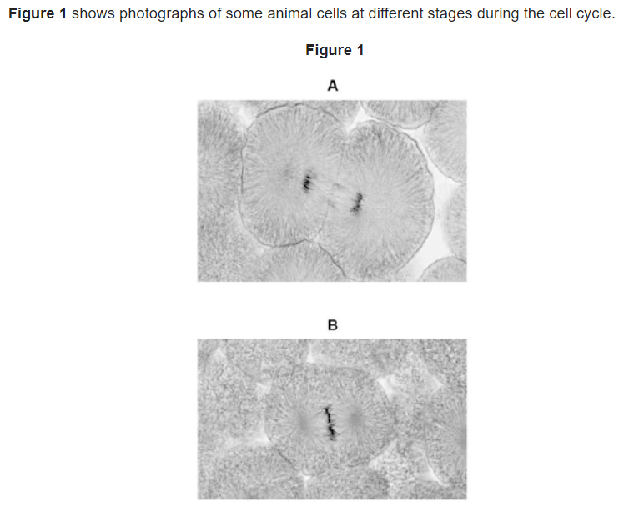
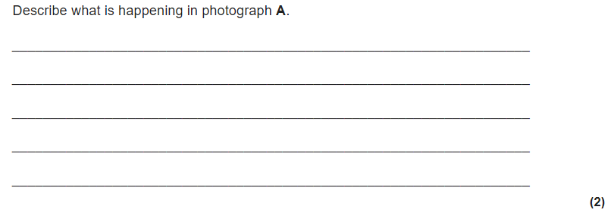

Slide 5
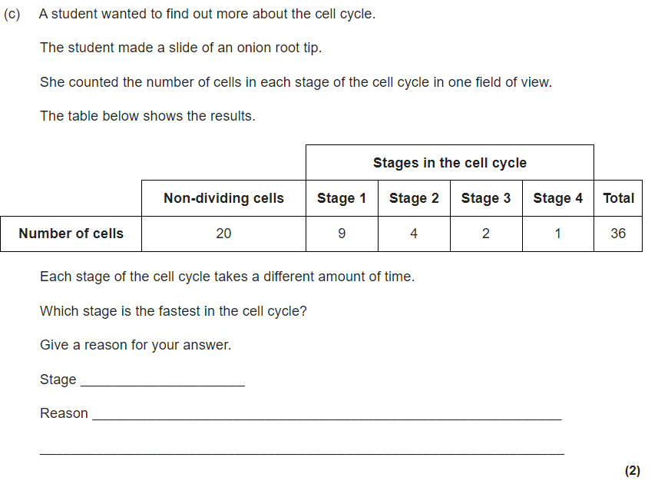
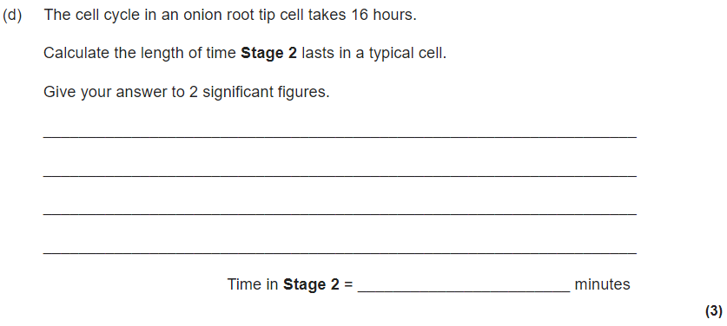

Slide 6
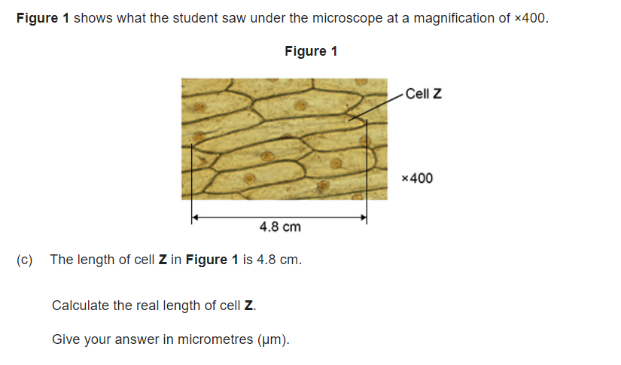
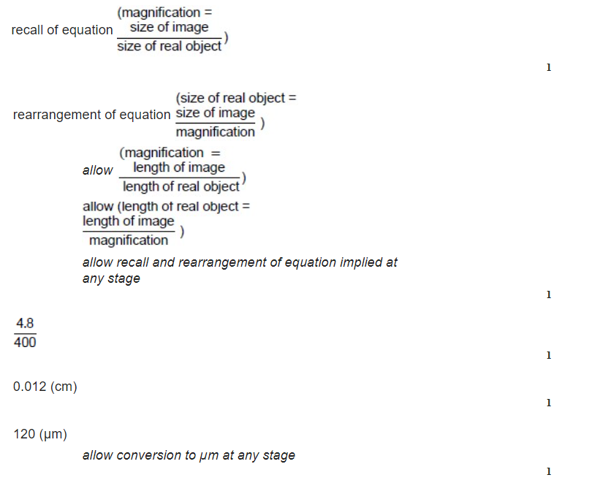

Slide 7
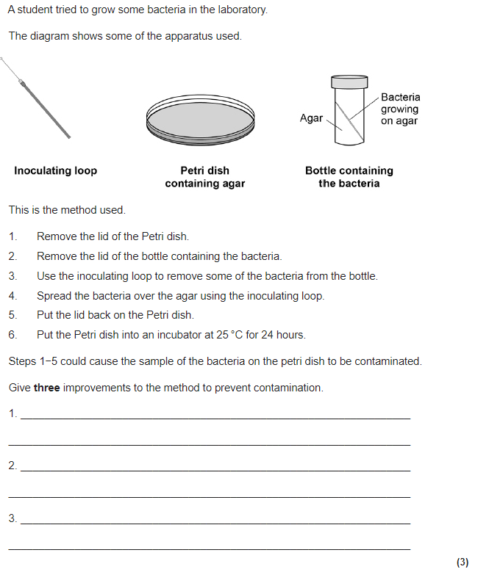
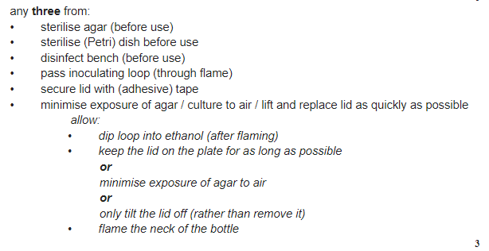

Slide 8
B2 Organisation Key Knowledge
Give a definition for a tissue
Name the organs that make up the digestive system
State the three types of tissue that are found in the stomach and what their function is
State two functions of hydrochloric acid in the stomach
State the function of the small intestine, large intestine, liver, gall bladder and pancreas
State what amylase breaks down and what products are formed
State what protease breaks down and what products are formed
State what lipase breaks down and what products are formed
State where amylase is made
State where protease is made
State where lipase is made
Explain why protease works best in the stomach
Describe and explain the function of bile
Describe how to test for starch, protein and glucose
State the four components of blood and their functions
State which type of blood vessel has thick walls and a narrow lumen
State which type of blood vessel has valves and the function of these
State which blood vessel has walls that are one cell thick and explain the advantage of this
State the name of the top chambers of the heart
State the name of the bottom chambers of the heart
State which chamber has the thickest walls and why this is important
State what is meant by a double circulatory system
State the function of coronary arteries
Describe what causes coronary heart disease
State two treatments for coronary heart disease
State where alveoli are found
Explain how alveoli are adapted for gas exchange
State the difference between a communicable and a non communicable disease
Give three risk factors for coronary heart disease
State the difference between a benign and a malignant tumour
Describe how a tumour spreads from one part of the body to another
Describe the function of stomata in plants and state where they are found
State the function of the following plant tissues: Epidermis, waxy cuticle, palisade mesophyll, spongey mesophyll, xylem, phloem, meristem
Describe how water is transported through plants
State how sugars are transported through plants

Slide 9
B2 Organisation Answers
Give a definition for a tissue A group of cells working together to carry out a specific function
Name the organs that make up the digestive system Mouth, oesophagus, stomach, small intestine, large intestine, anus, liver, gall bladder, pancreas
State the three types of tissue that are found in the stomach and what their function is Muscle – contracts to churn food, Epithelial – lines the stomach to protect it, Glandular – produces enzymes
State two functions of hydrochloric acid in the stomach Kill pathogens that could be found on food, provides a low pH for protease to work
State the function of the small intestine Absorbs nutrients into the bloodstream (have villi which increase the surface area), large intestine Absorbs excess water, liver Produces bile, gall bladder Stores bile and pancreas Produces three enzymes (amylase, lipase, protease)
State what amylase breaks down and what products are formed Breaks down starch into glucose
State what protease breaks down and what products are formed Breaks down proteins into amino acids
State what lipase breaks down and what products are formed Breaks down lipids into fatty acids and glycerol
State where amylase is made Pancreas, small intestine and MOUTH
State where protease is made Pancreas, small intestine and STOMACH
State where lipase is made Pancreas and small intestine
Explain why protease works best in the stomach Protease works best in acidic conditions, stomach contains hydrochloric acid
Describe and explain the function of bile Beaks up fat droplets into smaller droplets (emulsifies fats), giving them a larger surface area for lipase to break them down
Describe how to test for starch Add iodine, orange to black means starch is present, protein Add biuret solution, blue to purple means starch is present and glucose Add Benedict’s reagent, heat for 5 minutes, blue to yellow/orange/green/red means glucose is present.
State the four components of blood and their functions White blood cells – kill pathogens, Red blood cells – transport oxygen, Plasma – liquid that carries CO₂, urea, hormones, antibodies, other cells, Platelets – clotting blood
State which type of blood vessel has thick walls and a narrow lumen Artery – thick walls to withstand pressure, narrow lumen to maintain pressure
State which type of blood vessel has valves and the function of these Veins – valves prevent the backflow of blood
State which blood vessel has walls that are one cell thick and explain the advantage of this Capillaries – short diffusion path for oxygen/glucose to diffuse into cells
State the name of the top chambers of the heart Atrium
State the name of the bottom chambers of the heart Ventricles
State which chamber has the thickest walls and why this is important Left ventricle, so it can contract with more strength and push blood around the body, which is a further distance than to the lungs (right side)
State what is meant by a double circulatory system Blood is pumped from the right hand side to the lungs and the left hand side to the body
State the function of coronary arteries Supply oxygenated blood to the heart muscle itself, so that the heart muscle can respire and contract
Describe what causes coronary heart disease A built up of fatty tissue in the coronary arteries, reducing the flow of blood
State two treatments for coronary heart disease Statins – drugs which reduce cholesterol levels (no surgery needed, but have to take every day and can affect liver function), Stents – inserted to widen the artery (long term solution, but risk of infection with surgery and risk of blood clot forming around the stent)
State where alveoli are found Lungs
Explain how alveoli are adapted for gas exchange Thin walls - so short diffusion path, Good blood supply – diffusion is quicker, Large surface area – quicker diffusion
State the difference between a communicable Can spread from person to person and a non communicable disease Cannot spread from person to person
Give three risk factors for coronary heart disease Smoking, alcohol consumption, high fat/salt diet, lack of exercise, obesity
State the difference between a benign Cannot spread to other parts of the body and a malignant tumour Can spread to other parts of the body
Describe how a tumour spreads from one part of the body to another Cells break off and travel in the bloodstream
Describe the function of stomata in plants and state where they are found Found on the bottom side of leaves, allow gas exchange between the air and the leaf
State the function of the following plant tissues: Epidermis Protection, waxy cuticle Prevents water loss, palisade mesophyll Where most photosynthesis takes place, so have large surface area, are found at the top of the leaf and contain lots of chloroplasts, spongey mesophyll Where gases diffuse, xylem Transports water and nutrients, phloem Transports sugars (g;lucose), meristem Where cell division (mitosis) takes place
Describe how water is transported through plants Water evaporates from the stomata in the leaf, which pulls water up through the xylem (Transpiration)
State how sugars are transported through plants Translocation in the phloem

Slide 10
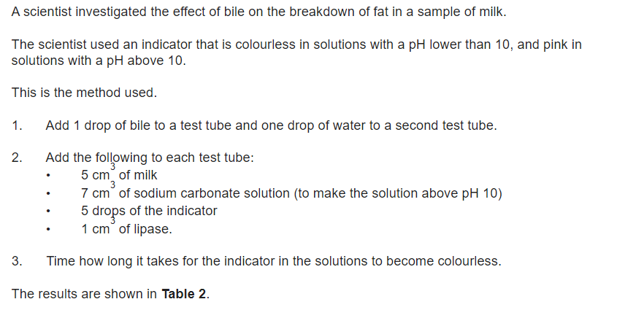
Can you identify:
Dependent variable
Independent variable
Control variables

Slide 11
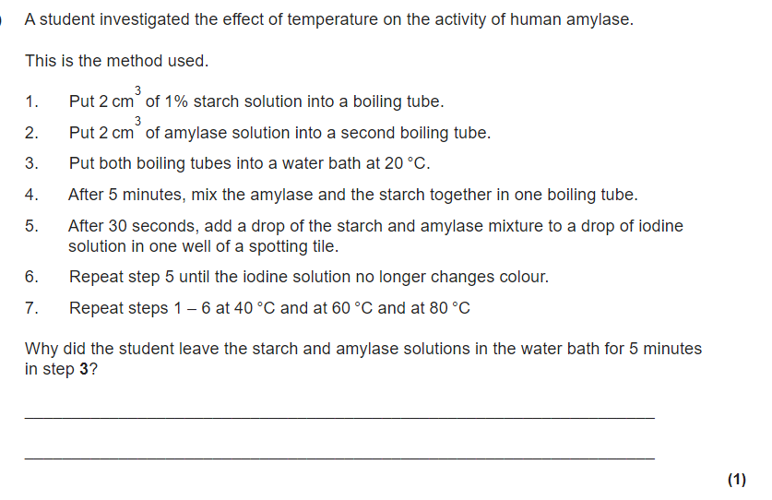
How many repeats would a scientist carry out?
Why are repeats important?
What is an anomalous result?
How are anomalous results dealt with?

Slide 12
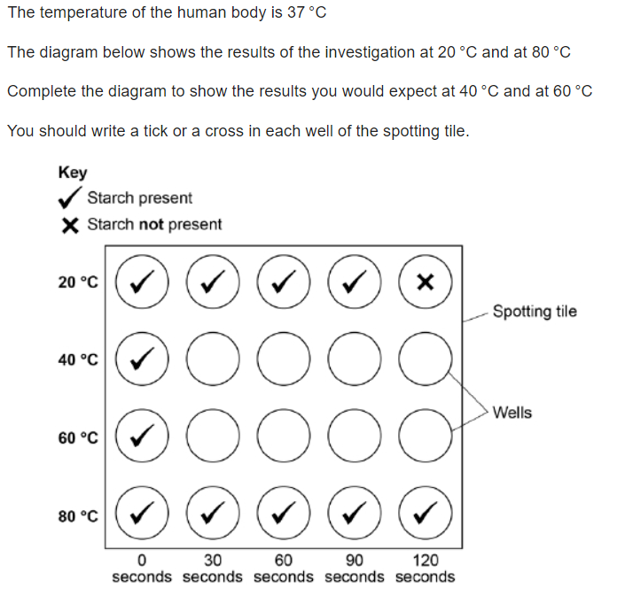
✓
✓
X
X
Can have 2 or 3 crosses
✓
X
X
X
Must have less crosses than 40°C

Slide 13
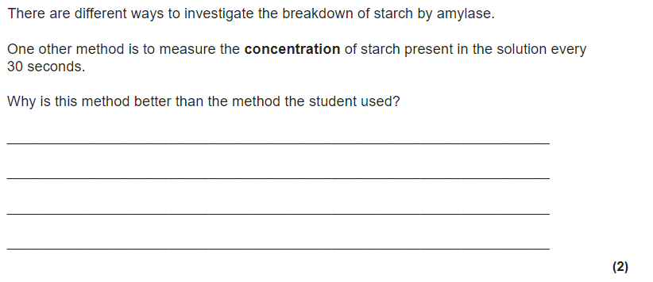
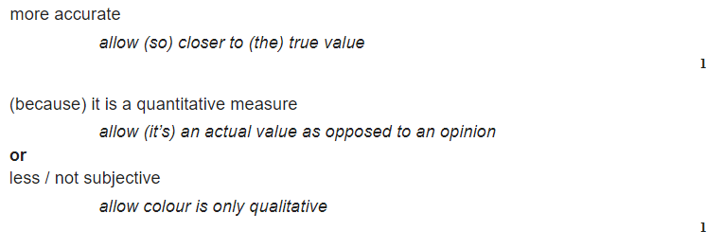

Slide 14
What is meant by the following key words:
Accurate
Repeatable
Reproducible
Precise
Measurement that is close to the true/actual value
Repeat investigation with the same apparatus by the same investigator and get the same/similar results
Repeat investigation with different apparatus by a different investigator and get the same/similar results
Results are clustered/close together

Slide 15
B3 Infection and Response Key Knowledge
Define the term pathogen
State how bacteria make us feel ill
State how viruses make us feel ill
Give three ways a pathogen could spread
State four types of pathogen
Describe how HIV makes a person more susceptible to other types of infection
Suggest how salmonella could be prevented from spreading
Suggest how gonorrhoea could be prevented from spreading
Suggest how infection with malaria could be reduced
Explain how rose blackspot leads to stunted growth
Describe three ways that white blood cells defend against pathogens
Explain how vaccination leads to immunity
State what drugs are used to treat bacterial infections
Explain why these can’t treat viruses
State how doctors can reduce the chance of antibiotic resistance developing
Describe the stages taken when developing and testing new drugs
State what a double blind trial is
Describe how monoclonal antibodies are made
Explain how magnesium deficiency can lead to stunted plant growth
Explain how nitrate deficiency can lead to stunted plant growth

Slide 16
B3 Infection and Response Answers
Define the term pathogen A microorganism that causes disease
State how bacteria make us feel ill Replicate and release toxins
State how viruses make us feel ill Replicate and damage our cells
Give three ways a pathogen could spread Droplet infection (breathing in from infected air), direct contact, uncooked food, sexual intercourse
State four types of pathogen Bacteria, virus, fungi, protists
Describe how HIV makes a person more susceptible to other types of infection HIV damages white blood cells, which means a person has less of them to kill other pathogens entering the body
Suggest how salmonella could be prevented from spreading Cook food thoroughly, give chickens antibiotics, kill infected chickens, wash hands after preparing food
Suggest how gonorrhoea could be prevented from spreading Protected sex – use of condoms
Suggest how infection with malaria could be reduced Use of nets to prevent people from being bitten in the first place
Explain how rose blackspot leads to stunted growth Causes discolouration of the leaf, so less chlorophyll, which means less sunlight is absorbed, so less photosynthesis and therefore less production of sugars
Describe three ways that white blood cells defend against pathogens Engulf pathogens, produce antitoxins, produce antibodies
Explain how vaccination leads to immunity Injects a person with a dead/inactive version of the pathogen. The white blood cells produce antibodies, which remain in the blood stream and are therefore already there if that pathogen enters the body again.
State what drugs are used to treat bacterial infections Antibiotics
Explain why these can’t treat viruses Viruses are found inside cells, so antibiotics cannot reach them/would have to damage the cell
State how doctors can reduce the chance of antibiotic resistance developing Only prescribe antibiotics for serious bacterial infections, not for viral infections like colds. Tell patients to take the full course of antibiotics. Prescribe the correct type of antibiotic for a specific bacterial infection. Prescribe the correct dose of antibiotic.
Describe the stages taken when developing and testing new drugs Tested on cells to check for toxicity. Tested on animals to check for toxicity and efficacy. Test on healthy volunteers to check for efficacy. Test on patients to test for dosage.
State what a double blind trial is When neither the patient or the doctor knows whether the patient receives the real drug or a placebo (doesn’t contain the drug, can be either a sugar pill or a saline injection)
Describe how monoclonal antibodies are made Antigen is injected into the mouse, the mouse’s lymphocytes produce the antibody for that antigen. White blood cells are fused with tumour cells to form a hybridoma. The hybridoma cells all produce the same type of antibody that can destroy the antigen needed.
Explain how magnesium deficiency can lead to stunted plant growth Magnesium is used to make chlorophyll, so less magnesium, means less chlorophyll is made. The leaf cannot absorb as much sunlight to photosynthesise and therefore doesn’t produce as many sugars. This means less proteins can be made for growth.
Explain how nitrate deficiency can lead to stunted plant growth Nitrates combine with glucose to produce amino acids needed for growth.

Slide 17
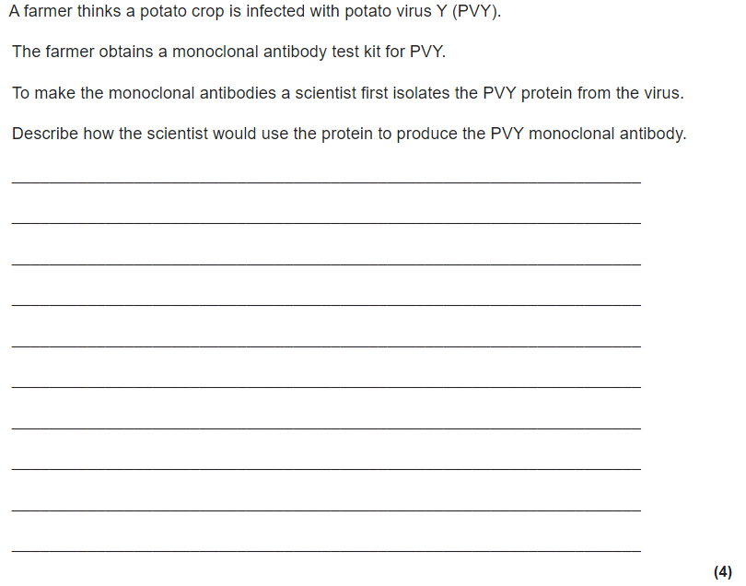
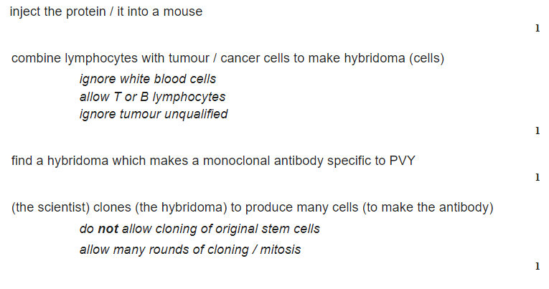

Slide 18
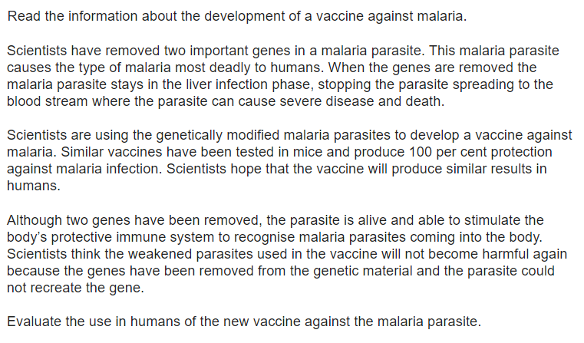
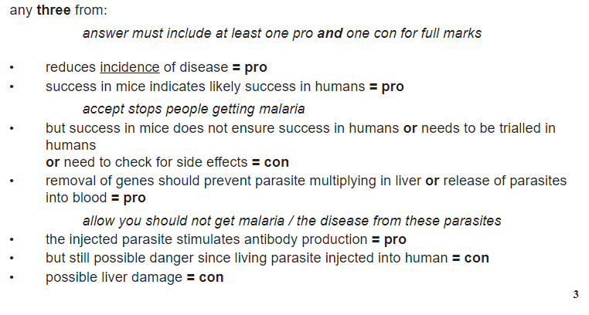

Slide 19
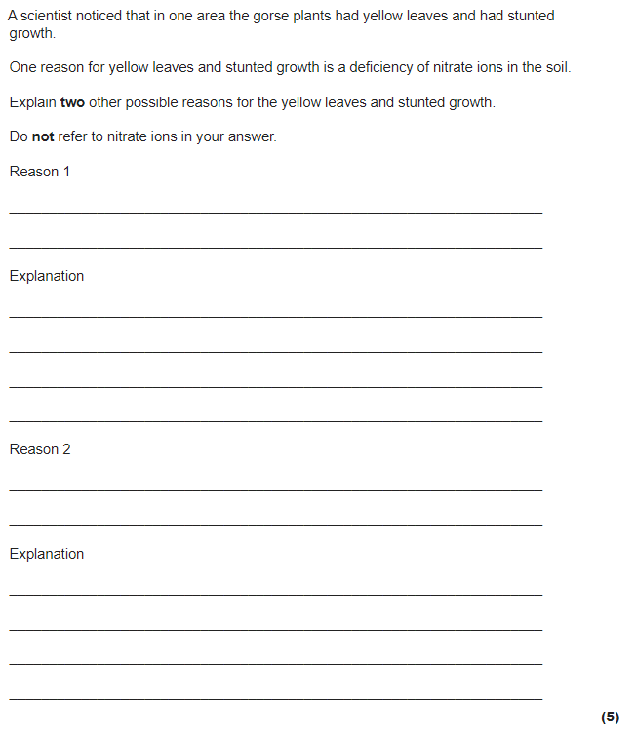
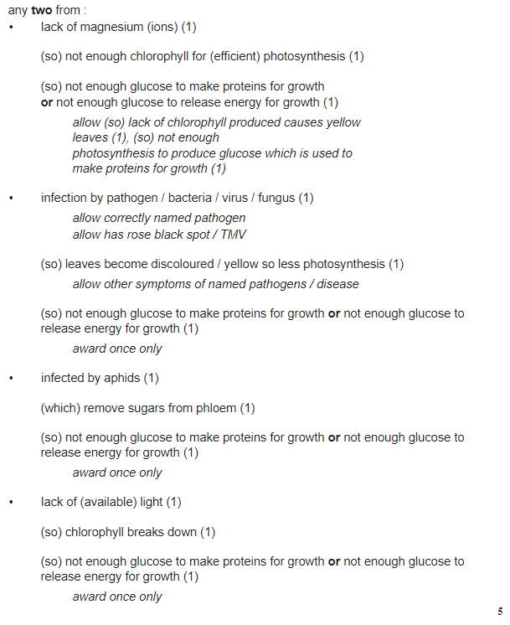

Slide 20
B4 Bioenergetics Key Knowledge
State the word and symbol equation for photosynthesis
State what is meant by a limiting factor
State factors that affect rate of photosynthesis
Explain how each factor affects rate of photosynthesis
State what type of reaction photosynthesis is
When distance from a lamp is doubled, light intensity reduces by a quarter. State the name of this law. (HT only)
Describe how you would investigate the effect of light intensity on rate of photosynthesis
Explain why it is beneficial to farmers to grow plants in greenhouses
State 5 uses of glucose
State the difference between aerobic and anaerobic respiration
State the word and symbol equation for aerobic respiration
State the word equation for anaerobic respiration in plants/yeast
Explain why this is useful in baking/brewing industries
State the word equation for anaerobic respiration in animals
Explain the effect of exercise on rate of respiration
State the effect of lactic acid build up in muscles
Describe how the body deals with a build up of lactic acid
State what is meant by metabolic rate (metabolism)
Give examples of 3 metabolic reactions in our cells

Slide 21
B4 Bioenergetics Answers
State the word and symbol equation for photosynthesis carbon dioxide + water → glucose + oxygen 6CO₂ + 6H₂O → C₆H₁₂O₆ + 6O₂
State what is meant by a limiting factor Something that affects the rate of photosynthesis
State factors that affect rate of photosynthesis Temperature, light intensity, concentration of carbon dioxide
Explain how each factor affects rate of photosynthesis Temperature – increasing the temperature to begin with increases the rate, as more kinetic energy means more collisions. However, after this the temperature is too high and enzymes denature. Light intensity – the higher the light intensity, the higher the rate of photosynthesis as it provides energy for the reaction to take place. CO₂ concentration – the higher this is the faster the rate of photosynthesis as thCO₂ is a raw material needed for photosynthesis to happen.
State what type of reaction photosynthesis is Endothermic – it absorbs light energy
When distance from a lamp is doubled, light intensity reduces by a quarter. State the name of this law. Inverse square law
Describe how you would investigate the effect of light intensity on rate of photosynthesis Place pond weed in a test tube of water and add sodium hydrogencarbonate (this provides CO₂). Place a lamp 10 cm from the pondweed and turn it on. Count the number of bubbles produced in one minute. Repeat this at different distances, e.g. 15, 20, 25, 30 cm. Repeat the investigation 3 times and calculate a mean for each distance. Things that should be kept the same: temperature, CO₂ concentration, volume of water, type of pondweed, amount of pondweed.
Explain why it is beneficial to farmers to grow plants in greenhouses Can control environmental conditions like temperature, light intensity and concentration of carbon dioxide to maximise the yield of crops/plants
State 5 uses of glucose Used in respiration, stored as starch, stored as lipids in seeds, combines with nitrates to produce amino acids, used to make cellulose for cell walls
State the difference between aerobic and anaerobic respiration Aerobic is with oxygen, anaerobic is without
State the word and symbol equation for aerobic respiration glucose + oxygen → carbon dioxide + water + energy C₆H₁₂O₆ + 6O₂ → 6CO₂ + 6H₂O + energy
State the word equation for anaerobic respiration in plants/yeast glucose → ethanol + carbon dioxide
Explain why this is useful in baking/brewing industries Produces CO₂ which is useful for baking to make bread rise. Produces ethanol, which is used in making alcohol.
State the word equation for anaerobic respiration in animals glucose → lactic acid
Explain the effect of exercise on rate of respiration Rate of respiration increases with exercise as more oxygen is needed to get to the respiring muscles so they can release energy for contraction. Breathing rate increases to get more oxygen into the body, heart rate increases to circulate the blood faster.
State the effect of lactic acid build up in muscles Causes cramps
Describe how the body deals with a build up of lactic acid Oxygen is needed to break down the lactic acid into carbon dioxide and water, which can then be removed from the body.
State what is meant by metabolic rate (metabolism) Rate of chemical reactions in cells
Give examples of metabolic reactions in our cells Respiration, production of lipids, production of proteins, break down of lipids, break down of proetins.

Slide 22
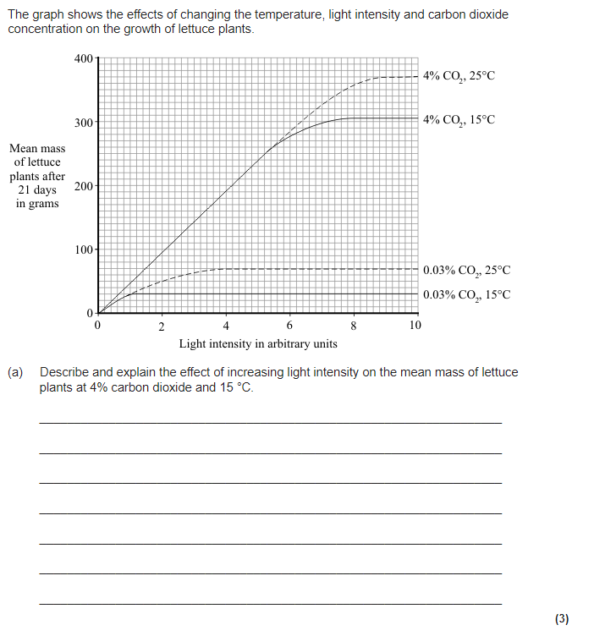
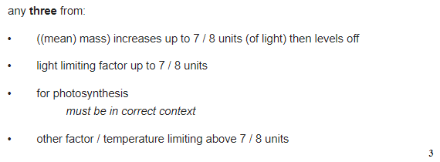

Slide 23
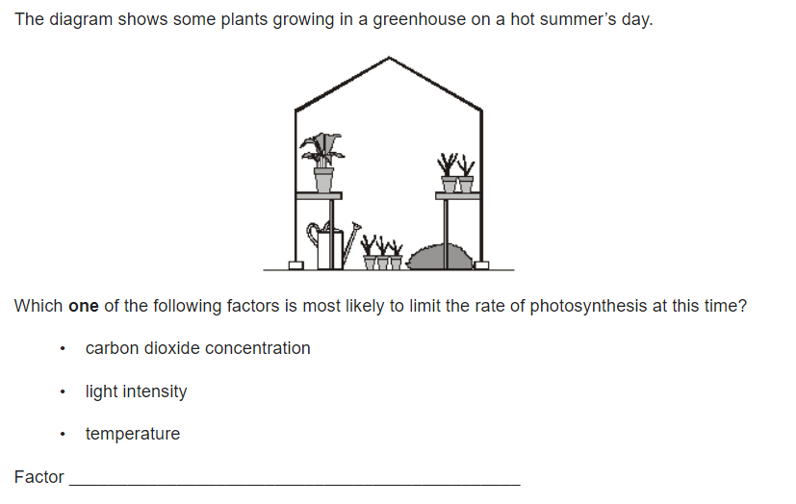
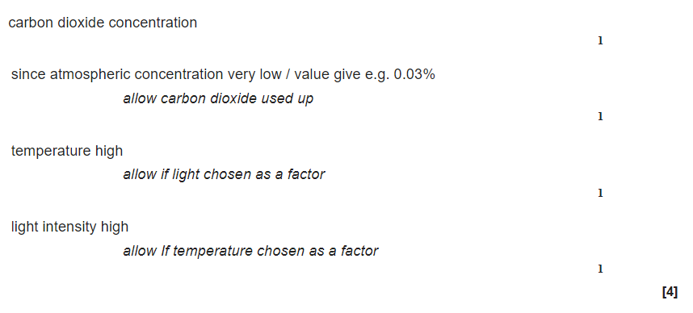
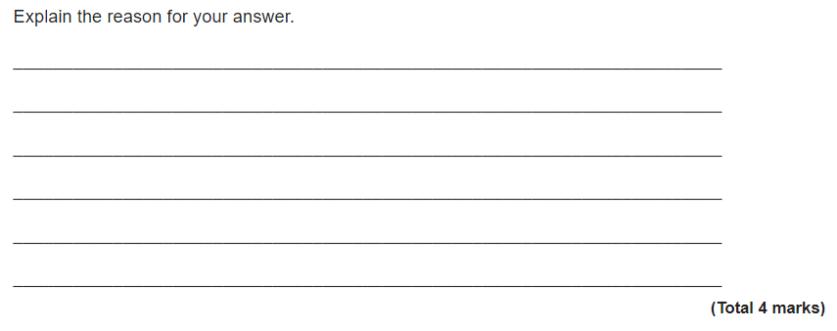

Slide 24
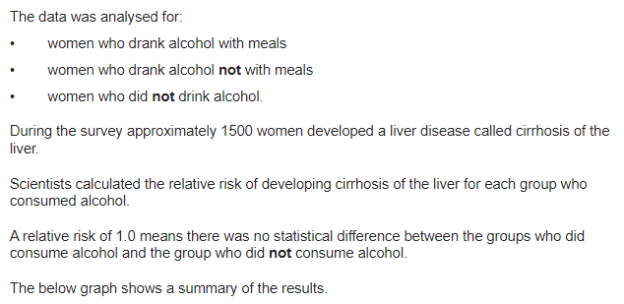
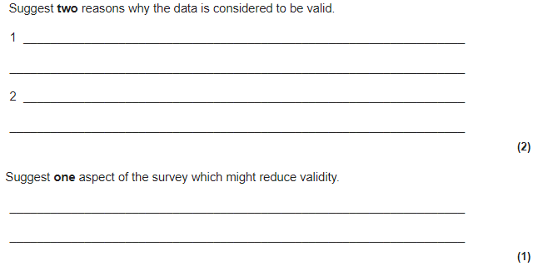
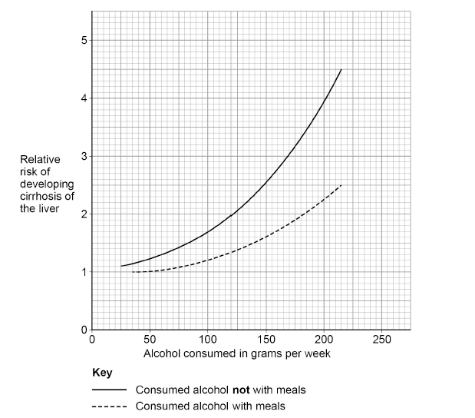
Valid = Suitability of the investigative procedure to answer the question being asked

