Slide 1
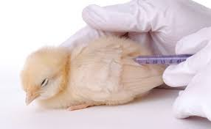
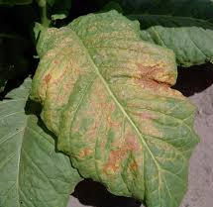
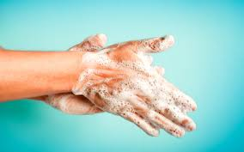
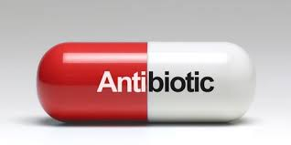
B3 Knowledge Organiser – 4.3 Infection and response
1
2
3
Communicable diseases
Pathogens are microorganisms that cause infectious disease.
Pathogens may be viruses, bacteria, protists or fungi.
They may infect plants or animals and can be spread by direct contact, by water or by air.
How to prevent the spread
Being hygienic- washing hands thoroughly
Killing vectors – killing vectors by using insecticides or destroying the habitat
Isolation- isolating an infected person will prevent the spread
Vaccination- people cannot develop the infection and pass it on
Viral diseases
Measles symptoms include fever & a red skin rash and can be fatal if complications arise. For this reason most young children are vaccinated against measles. The measles virus is spread by inhalation of droplets from sneezes and coughs.
HIV initially causes a flu-like illness. Unless successfully controlled with antiretroviral drugs the virus attacks the body’s immune cells. Late stage HIV infection, or AIDS, occurs when the body’s immune system becomes so badly damaged it can no longer deal with other infections or cancers. HIV is spread by sexual contact or exchange of body fluids such as blood which occurs when drug users share needles.
Tobacco mosaic virus (TMV) is a widespread plant pathogen. It gives a distinctive ‘mosaic’ pattern of discolouration on the leaves which affects the growth of the plant due to lack of photosynthesis.
Bacterial diseases
Salmonella (food poisoning)
Symptoms include fever, abdominal cramps, vomiting and diarrhoea. The salmonella bacteria is spread in food, or on food prepared in unhygienic conditions. In the UK, poultry are vaccinated against Salmonella to control the spread.
Gonorrhoea is a sexually transmitted disease (STD) with symptoms of a thick yellow or green discharge from the vagina or penis and pain on urinating. It easily treated with the antibiotic penicillin until many resistant strains appeared. Gonorrhoea is spread by sexual contact. The spread can be controlled by treatment with antibiotics or the use of a barrier method of contraception such as a condom.
6
8
4
Fungal & protists diseases
Rose black spot is a fungal disease where purple or black spots develop on leaves, which often turn yellow and drop early. It affects the growth of the plant as photosynthesis is reduced. It is spread in the environment by water or wind. Rose black spot can be treated by using fungicides and/or removing and destroying the affected leaves
The pathogens that cause malaria are protists. The malarial protist has a life cycle that includes the mosquito. Malaria causes recurrent episodes of fever and can be fatal. The spread of malaria is controlled by preventing the vectors, mosquitos, from breeding and by using mosquito nets to avoid being bitten.
5
2

Slide 2
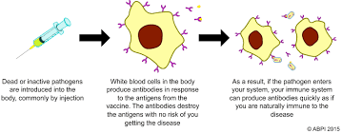
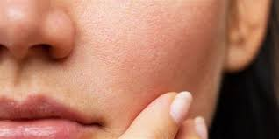
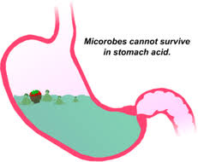
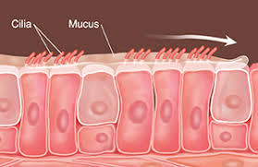
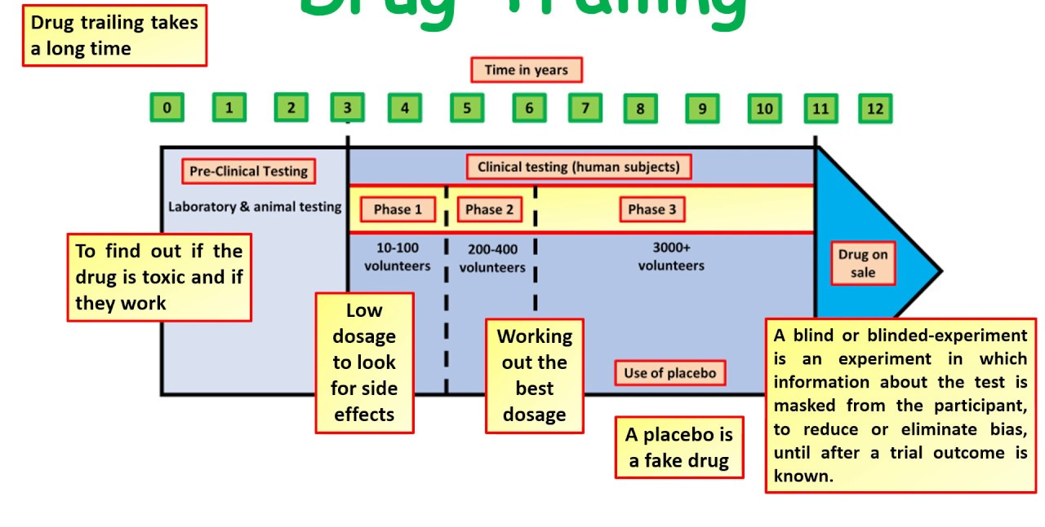
B3 Knowledge Organiser – 4.3 Infection and response
1
2
Human Defence System The non-specific defence systems of the human body against pathogens, including the: Skin. Nose, trachea, bronchi & stomach. |  | Vaccinations
 |  | Fighting disease – drugs Antibiotics cannot kill viral pathogens. It is difficult to develop drugs that kill viruses without also damaging the body’s tissues Painkillers and other medicines are used to treat the symptoms of disease but do not kill pathogens..
Discovery of drugs Traditionally drugs were extracted from plants & microorganisms. • The heart drug digitalis originates from foxgloves. • The painkiller aspirin originates from willow. • Penicillin was discovered by Alexander Fleming from the Penicillium mould. | Development of drugs Placebo = An inactive substance made to resemble a drug for researchers to use as a control.
Role of the immune system
If pathogens pass the non-specific first line of defence
they will cause an infection. However, the body has a
second line of defence to stop or minimise this infection.
This is called the immune system.
Phagocytes surround any pathogens in the blood and engulf them. They are attracted to pathogens and bind to them.
Lymphocytes recognise proteins on the surface of pathogens called antigens. Lymphocytes detect that these are foreign not naturally occurring within your body and produce antibodies. The antibodies cause pathogens to stick together and make it easier for phagocytes to engulf them.
Lymphocytes can also produce antitoxins to neutralise toxins.
3
4
5
6

