Slide 1
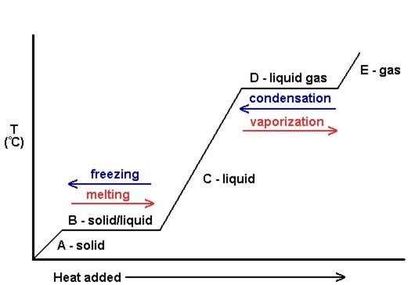
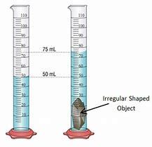
P3 Knowledge Organiser – 4.3.1 – Particle model
Quantity | Symbol | Unit
Density | ⍴ | kg/m³
Mass | m | kg
Volume | V | m³
Change in Thermal Energy | 𝚫E | J
Specific Heat Capacity | c | J/kg°C
Temperature Change | 𝚫θ | °C
Energy | E | J
Specific Latent Heat | L | J/kg
Pressure | p | Pa
Volume | V | m³
Constant | constant
Internal Energy
Is the energy that is stored inside a system.
Internal energy is the total kinetic and potential energy of all the particles
When heated, the energy stored by the particles increases.
This will raise the temperature of the system or will cause a change in state.
Temperature Change
The specific heat capacity of a substance is the amount of energy required to raise the temperature of 1kg of the substance by 1°C
Change in Thermal Energy = Mass x Specific Heat Capacity x Temperature Change
Solids
Liquids
Gases
Changes in State
Particle Motion in Gases
The temperature of the gas is related to the average kinetic energy of the molecules.
Changing the temperature of a gas, changes the pressure exerted by the gas.
The pressure of a gas on a solid surface is caused by the impact of the gas particles with the surface.
When a gas is heated the particles gain kinetic energy and so pressure increases.
Pressure in gases (TRIPLE)
Increasing the volume of a gas, at a constant temperature, leads to a decrease in pressure
Constant = Pressure x Volume
Changes of Heat and Specific Latent Heat
The specific latent heat of a substance is the amount of energy required to change the state of one kilogram of the substance with no change in temperature
energy for a change of state = mass × specific latent heat
Specific latent heat of fusion is the change of state from solid to liquid
Specific latent heat of vaporisation is the change of state from liquid to vapour.
Particles in a Liquid
Weaker forces of attraction between the particles
Not held together in a regular structure,
When heated, particles obtain enough energy to break forces of attraction and become a gas.
Density
Density is the measure of the mass per unit volume of a substance.
Density = Mass/Volume
Measuring the Density of a Solid Object
For an irregular shaped object lower it into a measuring cylinder partly filled with water and record the displacement. This is the volume.
Particles in a Solid
Particles are arranged in a regular structure.
There are strong forces of attraction between the particles and they vibrate about fixed positions.
When heated, particles energy increases and vibrate more.
If the solid is heated up enough, it will melt.
Increasing the Pressure of Gases (TRIPLE)
Doing work on a gas increases internal energy of the gas and causes an increase in temperature. E.G. if a tyre is inflated with a pump there would be work done so the internal energy of the gas increases which causes an increase of the temperature of the gas.

