Slide 1
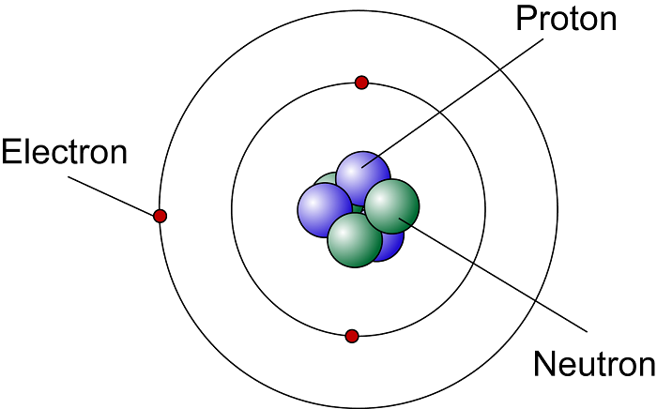
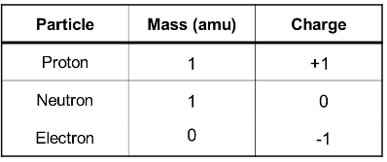
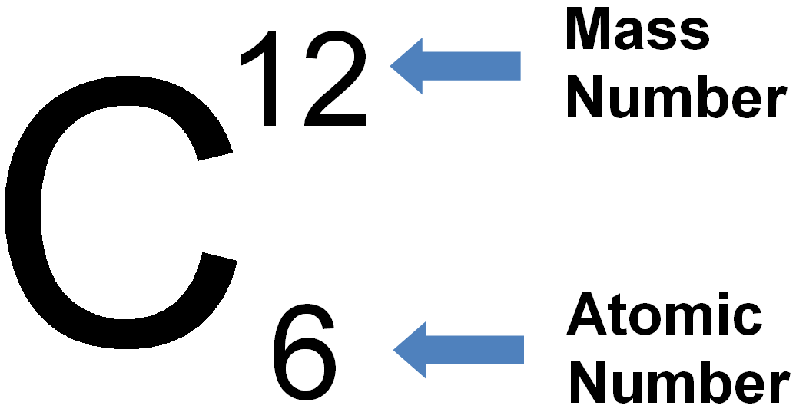
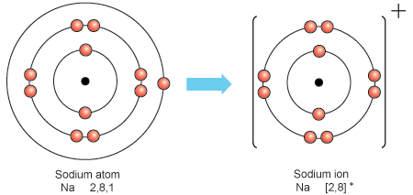
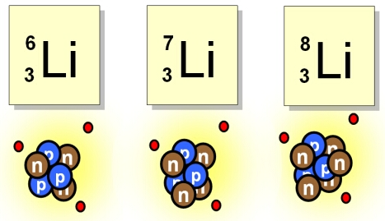
P4 Knowledge Organiser – 4.4.1 – Atomic structure
The Structure of an Atom Atoms have a radius of about 1×10⁻¹⁰m. | In an atom the number of electrons is equal to the number of protons in the nucleus and atoms have no overall electrical charge. | Development of the Model of the Atom Dalton suggested that atoms were tiny spheres that could not be divided. JJ Thompson then discovered the electron. He also suggested the Plum Pudding Model. Then due to results from the alpha particle scattering experiment the nuclear model of the atom was suggested. Niels Bohr suggested that electrons orbit the nucleus at specific distances and then James Chadwick proved the existence of neutrons.
Mass Number and Atomic Number The atomic mass is the total number of protons and number of neutrons. Atomic number is the number of protons in an atom
Ions A positive ion can be created is an atom loses one or more electrons. | Isotopes An isotope is an atom of the same element with a different number of neutrons.
Nuclear model | Plum pudding
Protons in nucleus | Positive ball of charge
Electrons in shells | Electrons randomly scattered
Neutrons in nucleus | No neutrons
Nucleus present | No Nucleus

Slide 2
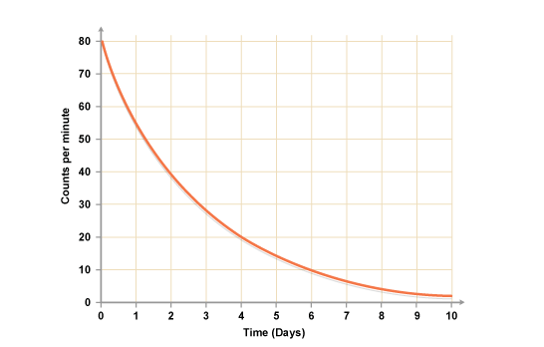
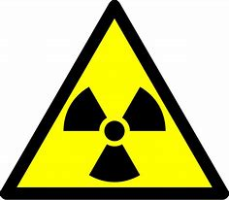
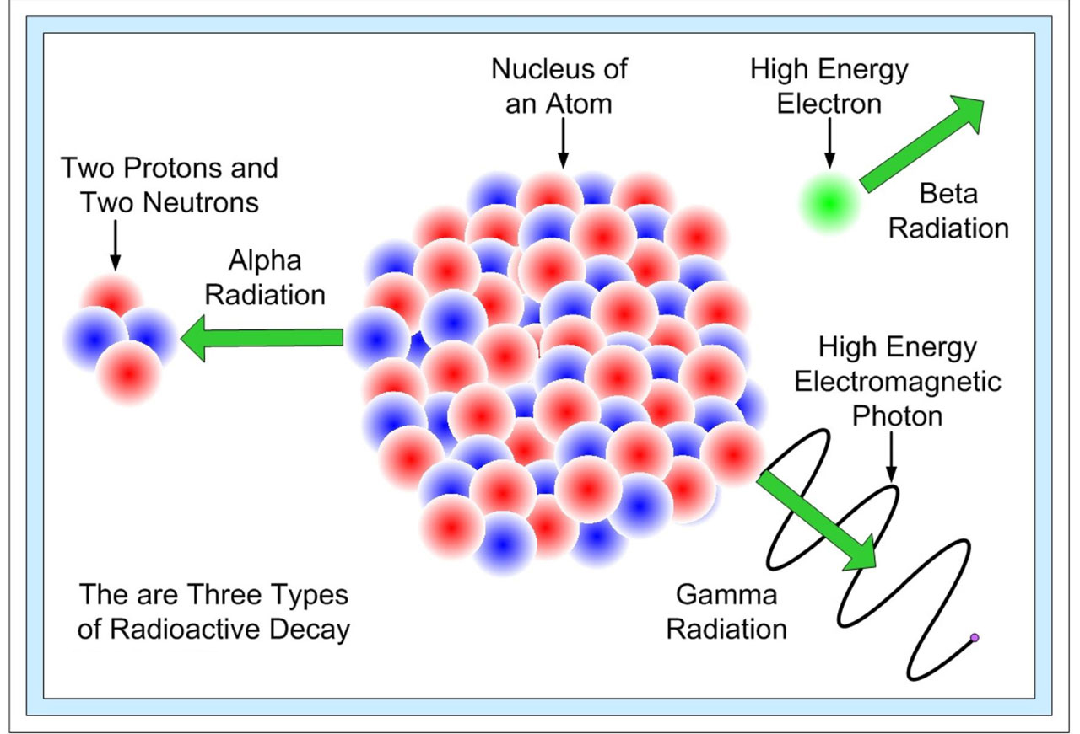
P4 Knowledge Organiser – 4.4.1 – Atomic structure
Half-Life The time it takes for the number of nuclei of the isotope in a sample to halve, or the time it takes for the count rate to fall to half its start level. |  |  | Radioactive Decay and Nuclear Radiation Some atomic nuclei are unstable. A nucleus can give out radiation in order to become more stable. This is a random process called radioactive decay. The nuclear radiation emitted can be in the form of alpha, beta or gamma radiation. |  |  | Contamination Contamination is the unwanted presence of materials containing radioactive atoms ending up on other materials. | Irradiation Irradiation is the process of exposing an object to nuclear radiation. The irradiated object does not become radioactive.
 |  |  | Gamma Decay The emission of a gamma ray does not cause the mass or the charge of the nucleus to change.
Alpha Decay An alpha particle (helium nucleus) is emitted from the nucleus. The is the symbol for the alpha particle. Notice that the mass number and atomic number are balanced on each side. |  |  | Beta Decay A beta particle (electron) is emitted from the nucleus when a neutron turns into a proton. The is the symbol for the beta particle. Notice that the mass number and atomic number are balanced on each side. The element has mutated because it now has an extra proton.
Radiation | Symbol | Consists of.. | Blocked By.. | Range in Air | Ionising Power
Alpha | α | 2 neutrons and 2 protons | Paper | 5cm | High
Beta | β | High speed electron | Thin Aluminium | 1m | Medium
Gamma | γ | Electromagnetic Radiation | Thick Lead/ Concrete | Infinite | Low

