Slide 1
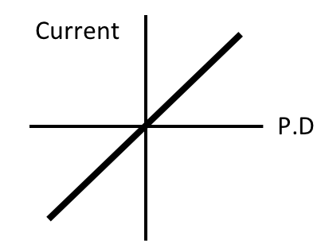
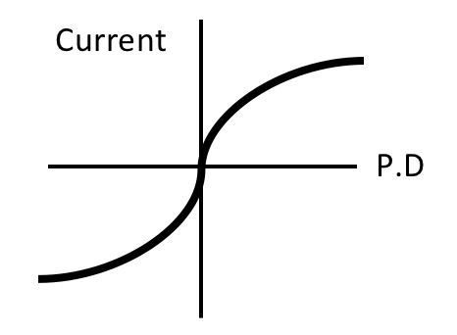
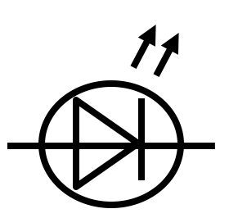
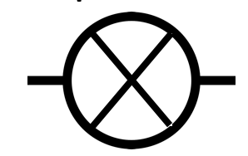
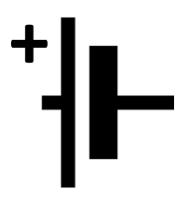
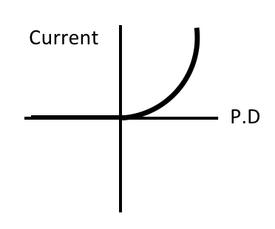
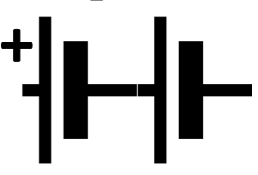
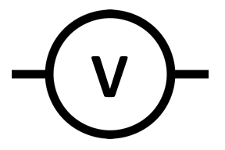
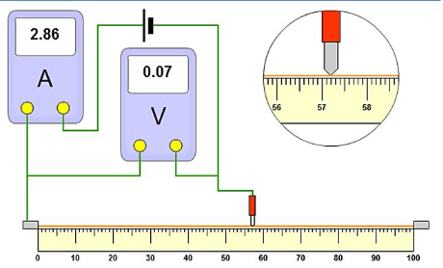
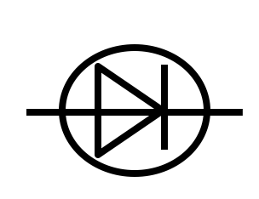
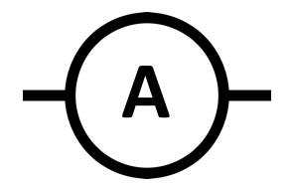
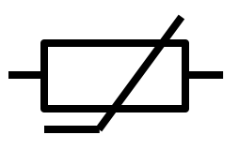
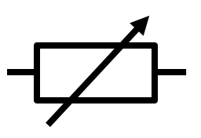
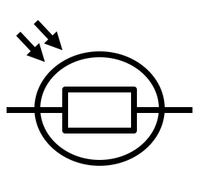
P2 Knowledge Organiser – 4.2.1 – Electricity
Component | Symbol | Component | Symbol
Open Switch |  | LED
Closed Switch |  | Lamp
Cell |  | Fuse
Battery |  | Voltmeter
Diode |  | Ammeter
Resistor |  | Thermistor
Variable Resistor |  | LDR
Resistors
The current through an ohmic conductor (at a constant temperature) is directly proportional to the potential difference across the resistor.
Filament Lamp
The resistance increases as the temperature increases.
Diode
The current flows in one direction only. The diode has a very high resistance in the reverse direction.
Required practical
Independent variable – Length of wire
Dependent variable – current and PD to calculate resistance
Control variable – Width of wire/ type of metal
Current, Resistance and Potential Difference
The current depends on the resistance and the potential difference
The greater the resistance of the component the smaller the current for a given potential difference
Potential Difference = Current x Resistance
V=IR
Series Circuits
Current is the same at any point in the circuit
The total potential difference of the power supply is shared between the components.
Total resistance is the sum of the resistance of each component: R total = R1 + R2
Parallel Circuits
The potential difference is the same
Current is shared between each branch
Total resistance of two resistors is less than the resistance of the smallest individual resistor.
Thermistors and Light Dependent Resistors
Resistance of a thermistor decreases as the temperature increases.
The resistance of an LDR decreases as light intensity increases.
Electrical Charge and Current
Circuit must include a source of potential difference.
Electric current is a flow of electrical charge.
The size of the electric current is the rate of flow of electrical charge.
Charge Flow = Current × Time
Quantity | Symbol | Unit
Charge | Q | C
Current | I | A
Time | t | s
Potential Difference | V | V
Resistance | R | Ω

Slide 2
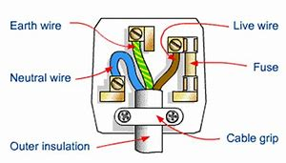
P2 Knowledge Organiser – 4.2.1 – Electricity
Direct and Alternating Potential Difference Mains electricity is an ac supply. In the United Kingdom the domestic electricity supply has a frequency of 50 Hz and is about 230 V. | Energy Transfers in Everyday Appliances The amount of energy an appliance transfers depends on how long the appliance is switched on for and the power output of the appliance. Energy Transferred = Power x Time Energy Transferred = Charge x Potential Difference Often the power of a domestic appliance is measured in kW. There are 1000W in 1kW. | National Grid A system of cables and transformers that links power stations to consumers Step-up transformers increase the potential difference from the power station before reaching the cables. Increasing the potential difference decreases the current, meaning less energy is wasted as heat The transmission cables have a low resistance, meaning less energy is wasted as heat. This increases the efficiency of the National Grid. Step-down transformers decrease the potential difference. This must happen before the supply reaches consumer for safety. For domestic homes the potential difference is decreased to 230V.
Mains electricity Most electrical appliances are connected to the mains using three-core cable. The insulation covering each wire is colour coded for easy identification: Live Wire – Brown – Carries current Neutral Wire – Blue – Completes the circuit Earth Wire – Green and Yellow Stripes - safety wire to stop the appliance becoming live. The earth wire is at 0 V, it only carries a current if there is a fault.
Quantity | Symbol | Unit
Energy Transferred | E | J
Power | P | W
Charge | Q | C
Potential Difference | V | V
Current | I | A
Resistance | R | Ω
Power
The rate of energy transfer (power) in any circuit is related to the potential difference across the circuit and the current through it.
Power = Potential Difference x Current
Power = (Current)² x Resistance
Static electricity (TRIPLE)
When insulating materials are rubbed together they become electrically charged
Negatively charged electrons are rubbed off one material onto another
The material that lost electrons becomes positively charged
The material that gains electrons becomes negatively charged

